Slide 1


Graphics Design II
Class 7
Lab 21

Slide 2


Way of Graphics Design
Online Tools
Offline Tools
Notes:
Notes to presenter:
Description of what you learned in your own words on one side.
Include information about the topic
Details about the topic will also be helpful here.
Tell the story of your learning experience. Just like a story there should always be a beginning, middle and an end.
On the other side, you can add a graphic that provides evidence of what you learned.
Feel free to use more than one slide to reflect upon your process. It also helps to add some video of your process.

Slide 3
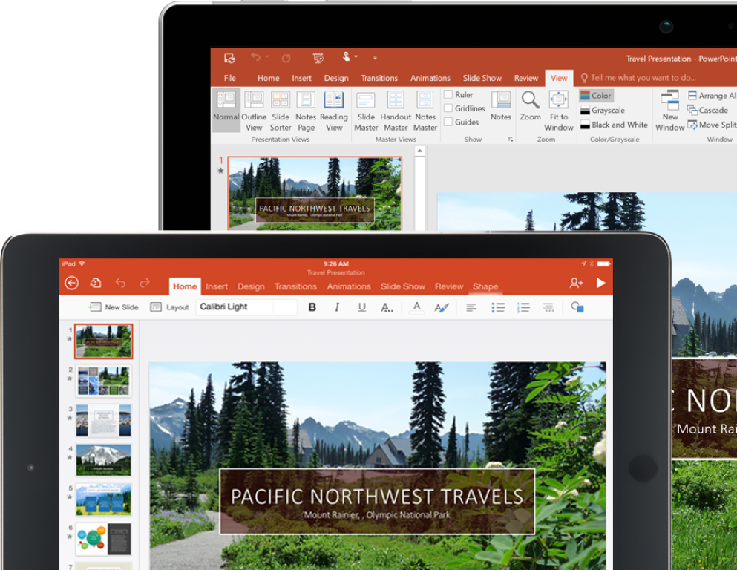
Microsoft PowerPoint
MS PowerPoint is a presentation slide making tool
Notes:
Notes to presenter:
Description of what you learned in your own words on one side.
Include information about the topic
Details about the topic will also be helpful here.
Tell the story of your learning experience. Just like a story there should always be a beginning, middle and an end.
On the other side, you can add a graphic that provides evidence of what you learned.
Feel free to use more than one slide to reflect upon your process. It also helps to add some video of your process.

Slide 4
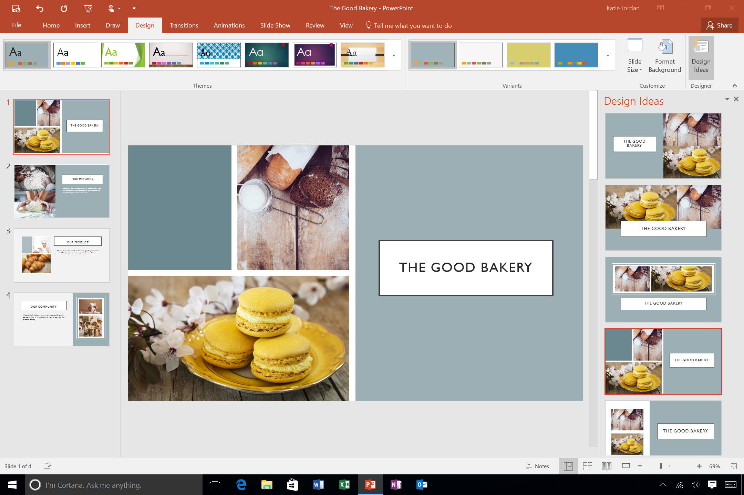
Microsoft PowerPoint
But we can use it for poster designing
Notes:
Notes to presenter:
Description of what you learned in your own words on one side.
Include information about the topic
Details about the topic will also be helpful here.
Tell the story of your learning experience. Just like a story there should always be a beginning, middle and an end.
On the other side, you can add a graphic that provides evidence of what you learned.
Feel free to use more than one slide to reflect upon your process. It also helps to add some video of your process.

Slide 5

Burger Selling Project
Write
a header
On texture
background
Notes:
Notes to presenter:
Description of what you learned in your own words on one side.
Include information about the topic
Details about the topic will also be helpful here.
Tell the story of your learning experience. Just like a story there should always be a beginning, middle and an end.
On the other side, you can add a graphic that provides evidence of what you learned.
Feel free to use more than one slide to reflect upon your process. It also helps to add some video of your process.

Slide 6

Burger Selling Project
Copy a
transparent
burger from
Google
And paste it on
your slide
Notes:
Notes to presenter:
Description of what you learned in your own words on one side.
Include information about the topic
Details about the topic will also be helpful here.
Tell the story of your learning experience. Just like a story there should always be a beginning, middle and an end.
On the other side, you can add a graphic that provides evidence of what you learned.
Feel free to use more than one slide to reflect upon your process. It also helps to add some video of your process.

Slide 7
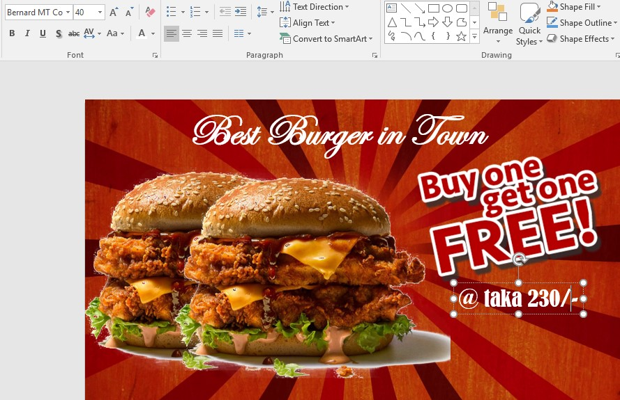
Burger Selling Project
Add Buy
one get one
sticker with
your price
Notes:
Notes to presenter:
Description of what you learned in your own words on one side.
Include information about the topic
Details about the topic will also be helpful here.
Tell the story of your learning experience. Just like a story there should always be a beginning, middle and an end.
On the other side, you can add a graphic that provides evidence of what you learned.
Feel free to use more than one slide to reflect upon your process. It also helps to add some video of your process.

Slide 8

Burger Selling Project
Export
as a
JPEG file
Notes:
Notes to presenter:
Description of what you learned in your own words on one side.
Include information about the topic
Details about the topic will also be helpful here.
Tell the story of your learning experience. Just like a story there should always be a beginning, middle and an end.
On the other side, you can add a graphic that provides evidence of what you learned.
Feel free to use more than one slide to reflect upon your process. It also helps to add some video of your process.

Slide 9


